Slide 1
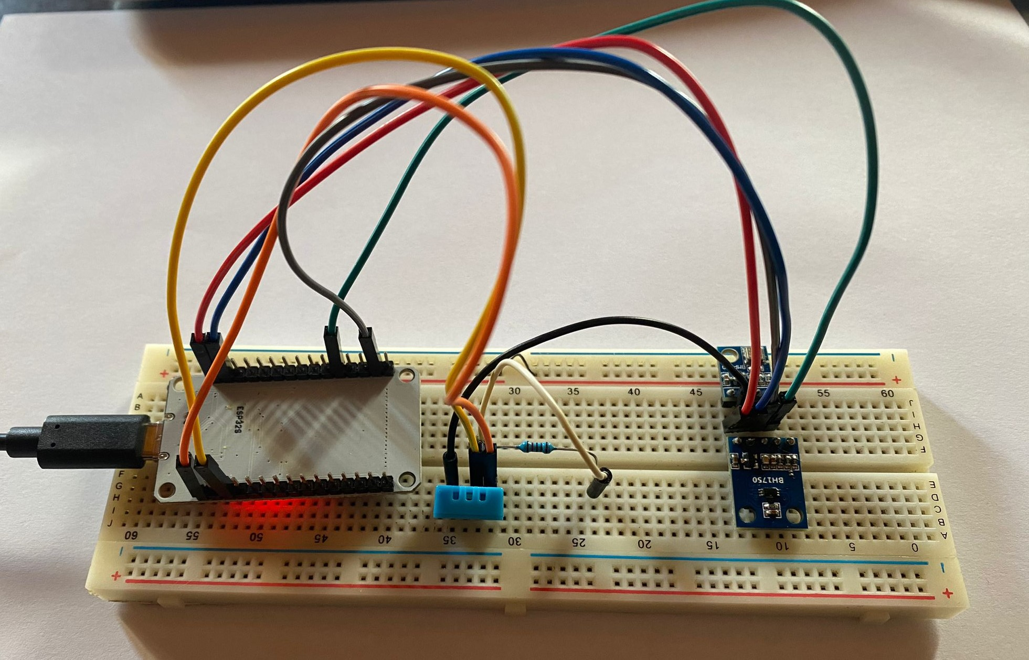
Distributed Weather Station
University of Trento
Embedded Software for the Internet of Things
Brognara Alessandro
Cappellaro Nicola
Zannoni Riccardo

Slide 2
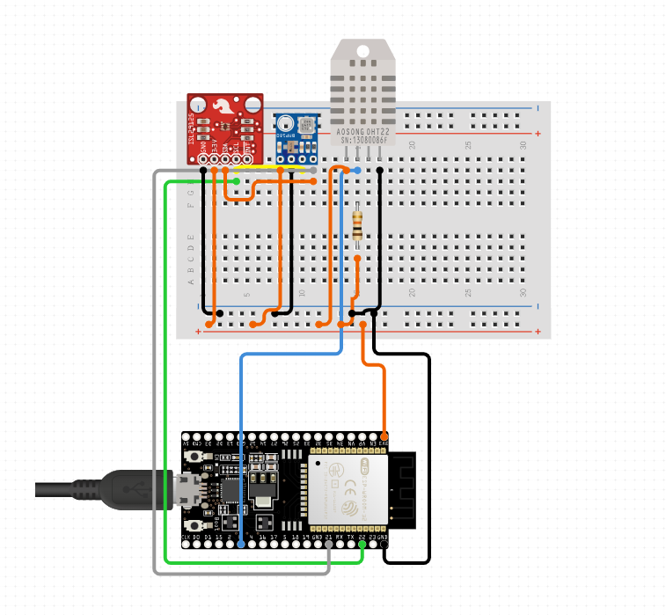
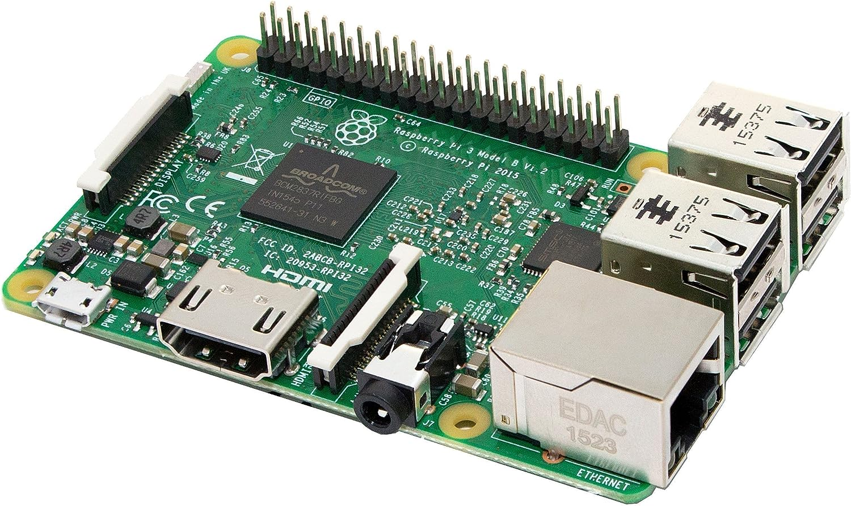
Project description:
what is the goal of the project?
Our project is a distributed weather station with:
a central server;
two weather stations with sensors
The stations periodically carry out a measurement of meteorological data (temperature, humidity, pressure, altitude and light intensity) and send it to a web server which allows the data to be displayed.

Slide 3
Software Architecture
4. raspberry display the data with a nodeJs web server
ESP32
Web
1. esp32 connect to wifi
2. interrupt function read the sensor data and prepare a json
Interrupt
Raspberry
3. the json is sent to the server

Slide 4
Software Architecture
Work flow
Initialization: In the setup() function, the code initializes the serial communication, sensors, and WiFi connection.
Interrupts and Timers: The Ticker object timer is used to create an interrupt that triggers the sendData() function every 10 seconds.
Data Collection: In the sendData() function, the code collects data from each sensor. If there’s an error in reading the data (indicated by isnan()), it assigns a default value of -2.
Data Transmission: If the WiFi connection is active, the code creates an HTTP client, specifies the server URL, and sets the content type to JSON. It then constructs a JSON string with the sensor data and location of the weather station, and sends this data to the server using a POST request. The server’s response is printed to the serial monitor.

Slide 5
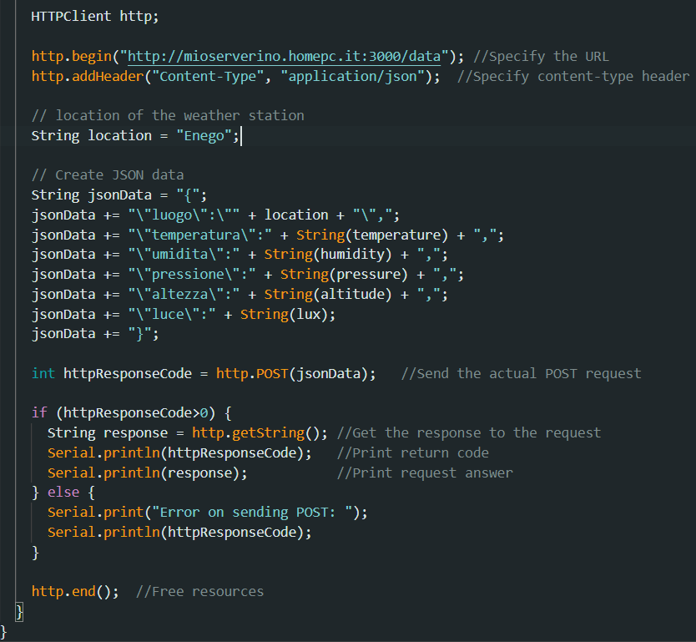
Testing
Representative code
Sensor Testing: Each sensor was tested individually to ensure accurate data collection.
Connectivity Testing: We verified the WiFi connection and server communication.
Final testing: Finally, we tested the entire system together, ensuring the perfect interaction of all components.
The most challenging part of the project was the communication between the weather stations (esp32) and the server (raspberry), in particular:
esp32 side: format the data into a json and send them to the server;
server side: receive the data and process them
prepare the json and send the data to the server

Slide 6

Team member contribution
Conclusion and Future Work
The project was created by all members of the group together, each member contributed on all parts of the project. However, we can highlight the areas of greatest competence for each member:
Brognara Alessandro (sensor testing with arduino IDE)
Cappellaro Nicola (interconnection between ESP32 and Raspberry, ESP32 coding)
Zannoni Riccardo (website and javascript coding)
In conclusion, we learned to use a new esp32 microcontroller and created the circuit to read the data from the sensors, plus connected the project to the internet making it complete in every area.
This project is easily scalable, in the future we can add:
sensors: to make measurement of other type of data, such as the wind sensor, the rain sensor, ...
stations: in order to cover a larger geographic area, we can add new weather stations.
In addition, we can implement the storage of the data using a database. In this way we can build graphic with a larger number of data instead of the last 24 hours only.

